Slide 1
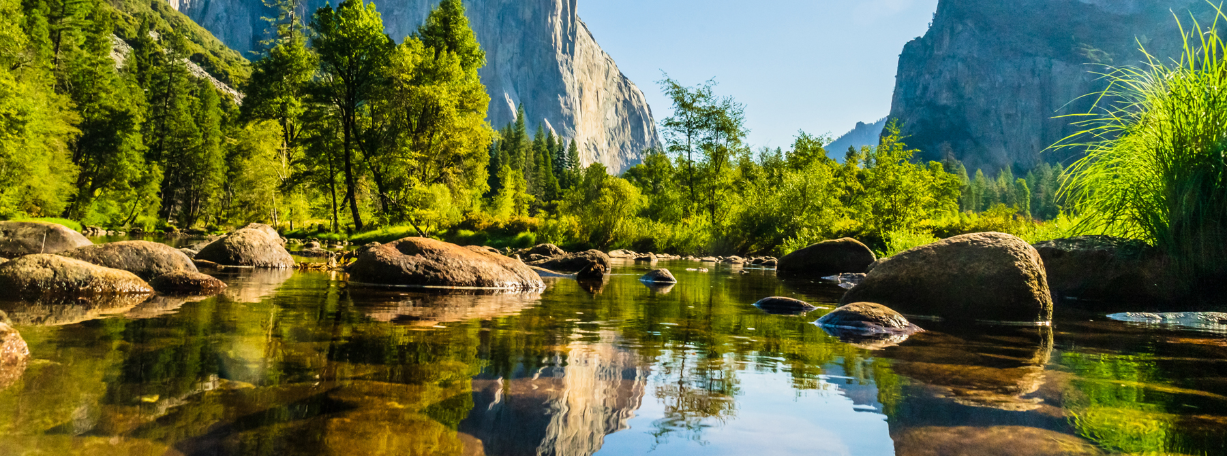
National Park & Trail Recommender Model
DSCI 521 Term Project
Xi Chen, Tien Nguyen, Tuan Huynh, Stephen Yi
June 6, 2021

Slide 2
Table of Contents
Overview
Datasets
Usage
Development
Challenges and Limitations
Workload Distribution
Demonstration
Future Work

Slide 3
Overview
Application
Users
This project creates a recommender system which suggests relevant national parks/trails to the users based on their preferences
The datasets used were from a DSCI 511 project and Kaggle, which contain information about over 400 US national parks/trails
The recommender system should be helpful for anyone looking to visit the national parks and spend time in the vicinity of nature for recreation
It will help them search for the place to visit depending on their interests

Slide 4
Datasets
National Parks Dataset:
7 features: name, park id, latitude, longitude, description, activities, weather information
467 samples
All Trails Dataset:
(trails_data.csv and AllTrails data – nationalpark.csv)
18 features: popular rating, difficulty rating, route type, activities.
3,313 samples

Slide 5
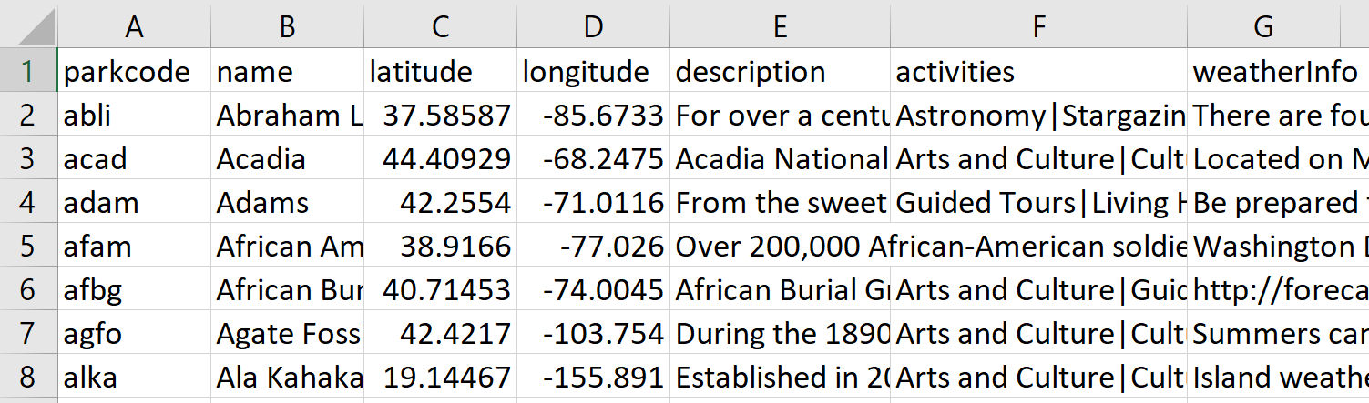
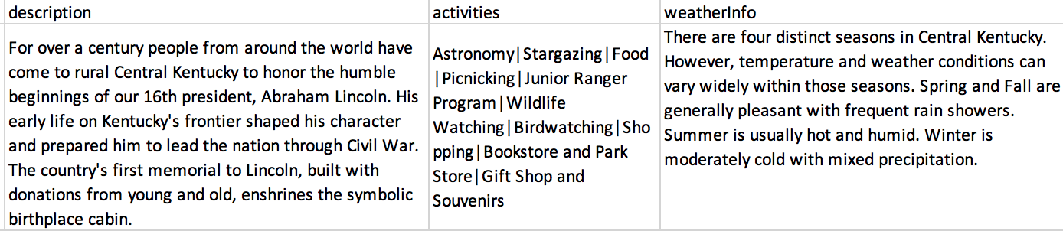
Sample Dataset
National Parks Dataset: 7 features and 467 samples

Slide 6
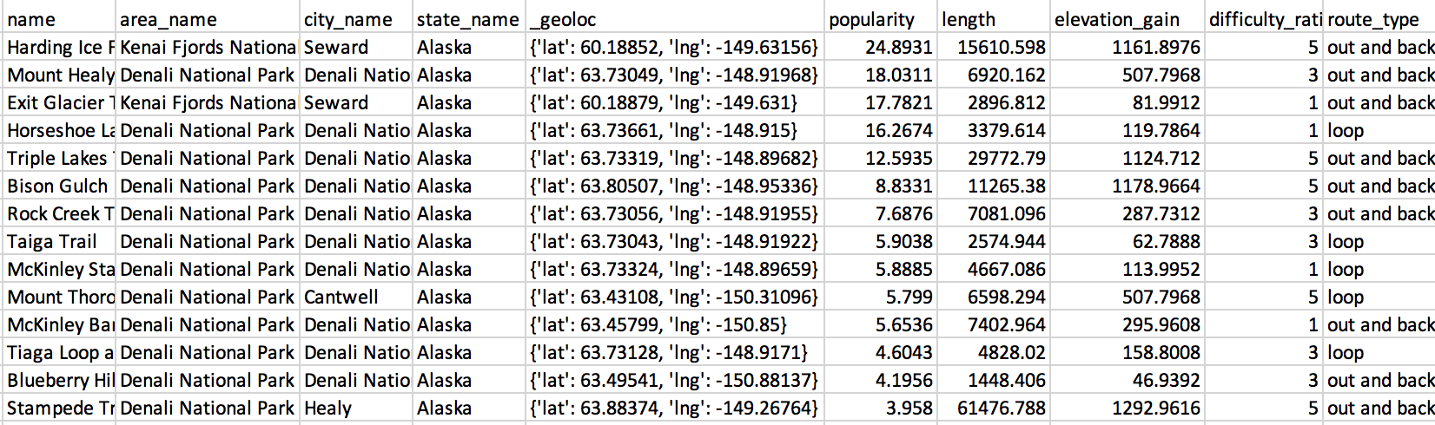
Sample Dataset
All Trails Dataset: 18 features and 3,313 samples

Slide 7
Usage
Download Files
Download User_Quiz.ipynb, recs.py, nationalpark.csv, trails_data.csv, and AllTrails data – nationalpark.csv
Run
Once downloaded, simply run the module User_Quiz.ipynb
Answer the Questions
Users will answer questions based on their preferences
View
View the recommended national parks/trails

Slide 8




Development User_Quiz.ipynb and recs.py
Gather data from Kaggle and DSCI 511 project
Implement a quiz to prompt user’s preferences
Vectorize dataset to obtain TF-IDF matrices
Generate recommendations

Slide 9

Demonstration

Slide 10
Challenges and Limitations
1. TF-IDF usage on some metrics:
TF-IDF Matrix was used on activities, where each document was a short list of words, instead of sentences
Every word was significant
Skewed output of the matrix, with trails/parks with fewer activities overall getting higher scores
2. AllTrails Dataset for popularity and difficulty
Popularity was just a number, no rating out of 10 or other explanation from Kaggle
Difficulty was range from 0-7, once again no explanations
Used ranges to group popularity and difficulty by percentile for our prompt function

Slide 11
Challenges and Limitations
3. How to weigh rank choice
Want to provide user option to rank responses
Decided on weighting of (1-(i/n))
4. Limiting user's response options
Some options not present in all parks
May not provide as good a recommendation

Slide 12
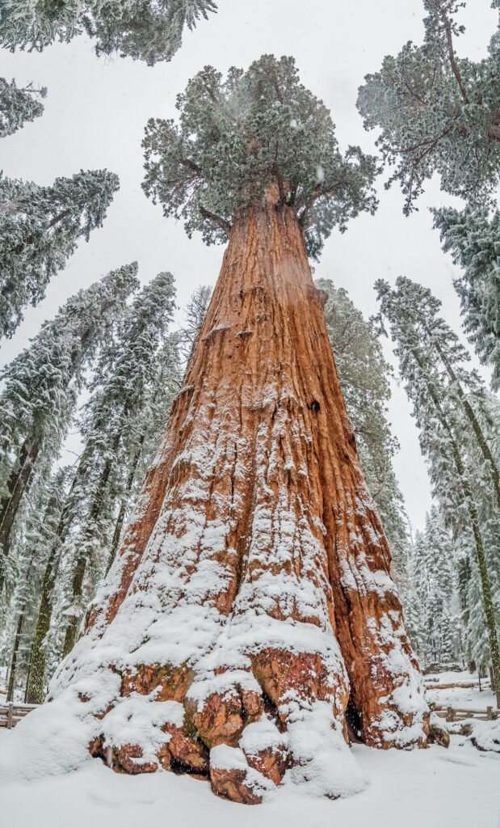

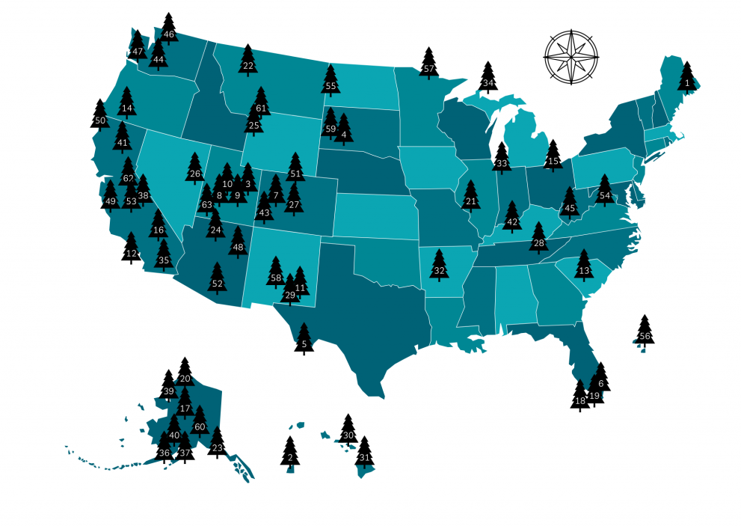
Future Work
Generate more information or pictures for each park/trail
Biodiversity
Visualize locations of parks/trails on a map
Steller’s Jay at Mount Rainier NP
General Sherman – World’s largest tree, at Sequoia NP
https://www.goodhousekeeping.com/life/travel/g4213/50-stunning-animals-from-our-national-parks/?slide=49
https://trekkn.co/printable-us-national-parks-map/

Slide 13
Workload Distribution
Xi Chen
Development of recommendation algorithm based on the NationalParks.csv dataset
Tuan Huynh
Started rough draft of recommendation system based on filtering through user input
Tien Nguyen
Developed questions to prompt the users
Stephen Yi
Development of recommendation algorithm based on AllTrails.csv dataset

Slide 14
Thank you!

